Slide 1
Introduction to Neural Networks
Jackie Ye, CIS4930, Spring 2026

Slide 2
Today’s Outline
Neural Network Basics
Machine Learning Procedure
Different Neural Networks
  Convolutional Neural Network (CNN)
  Recurrent Neural Network (RNN)
  Transformers
Common Neural Network modelling approaches
  Diffusion
  Auto-Regressive
  Agents

Slide 3
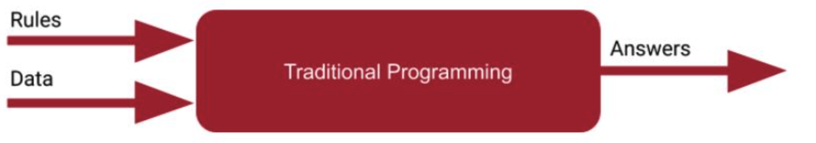
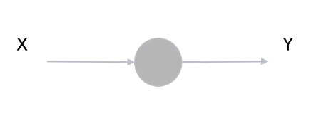
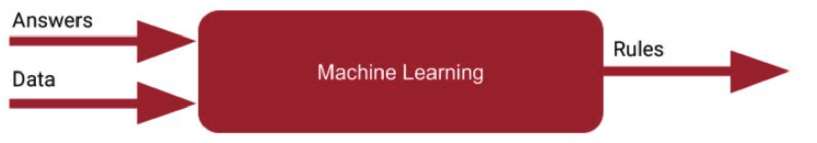
NN Basics: Key Concepts
Layer
Model, Layer, Neuron:
Neuron(simply, a function, with two learnable parameters)
Known a + b = 3
Given a = 1, solve b
How?
Input data(x) and rules, generate answers (y)
Given: a, b
Slove: Relation?
-1.0 -> -3.0
0.0 -> -1.0
1.0 -> 1.0
2.0 -> 3.0
3.0 -> 5.0
4.0 -> 7.0
Find a model with single layer and a single neuron
Input data(x) and answers(y), generate rules
Output = (Weight * Input) + Bias​
Y = AX + B (Linear)

Slide 4
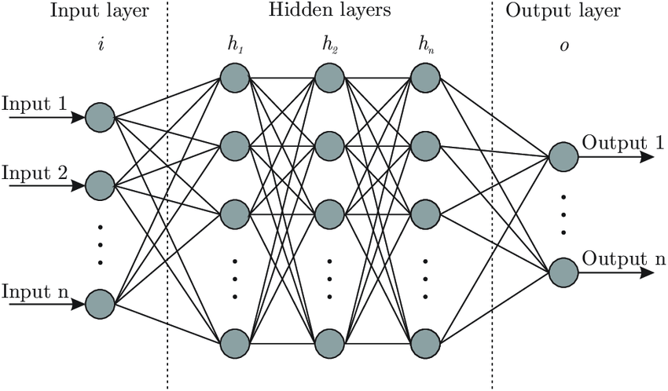
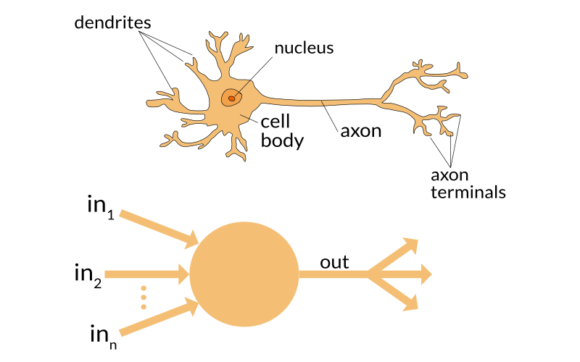
Deep Neural Network
Perceptron
Multiple-Layer Perceptron (MLP)

Slide 5
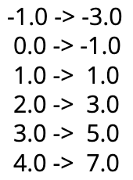
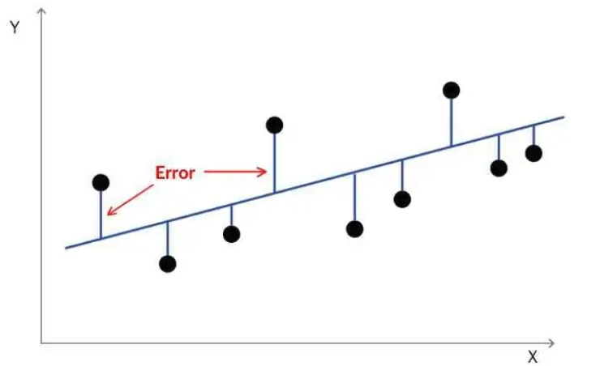
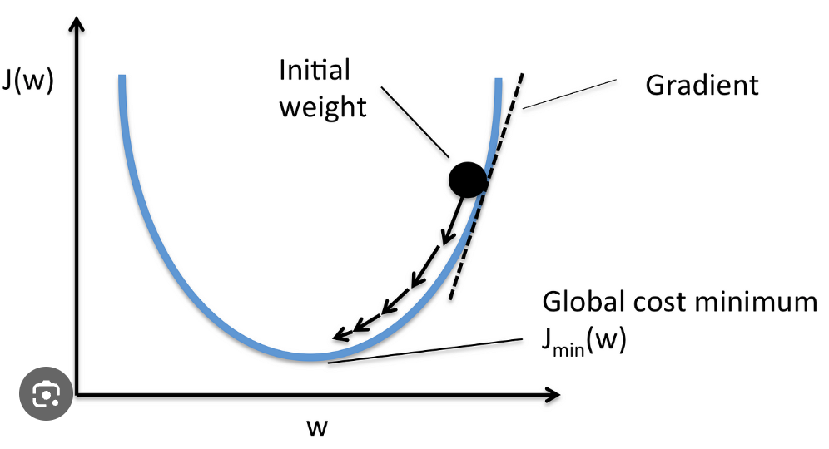
Common Machine Learning Procedure
Pre-process data
Define network
Define loss function
Define optimizer
Training model
Validation and Testing
Output = (Weight * Input) + Bias​
Y = AX + B (Linear)
A1,B1 -> A2,B2 -> A3,B3 ->...
Evaluate the difference between x and y
minimize the loss function by updating the model's parameters (like weights and biases)
Input data repeatedly and optimize the parameters
Evaluate the model's performance
How it work? Good explanation from 3Blue1Brown

Slide 6
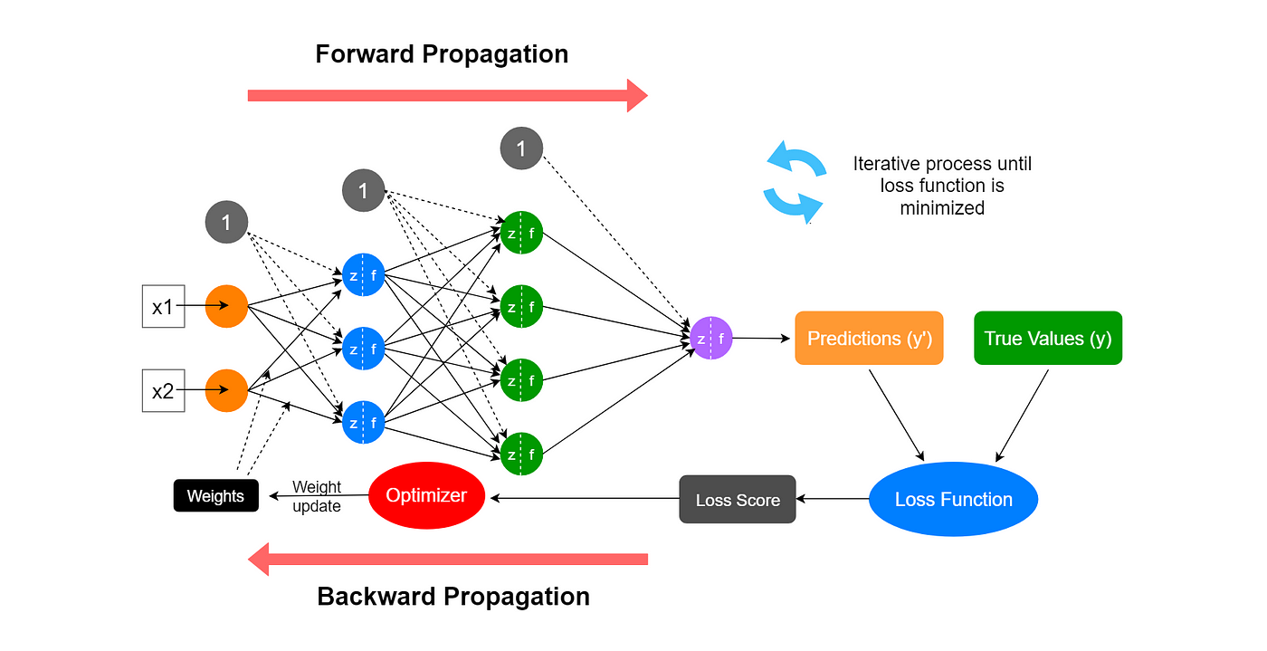
ML Steps
Pre-process data
Define network
Define loss function
Define optimizer
Training model
Validation and Testing

Slide 7
Convolutional Neural Network (CNN)
Key idea: Use local receptive fields and shared weights to capture spatial patterns efficiently.
Why CNN?
  Many data types have strong spatial structure
    Images, Spatial sensor data, etc.
  Fully connected networks (MLP) ignores spatial locality and is too heavy
  Thus, we need a model that
    Exploits local patterns
    Scales to high-dimensional inputs
    Is computationally efficient

Slide 8
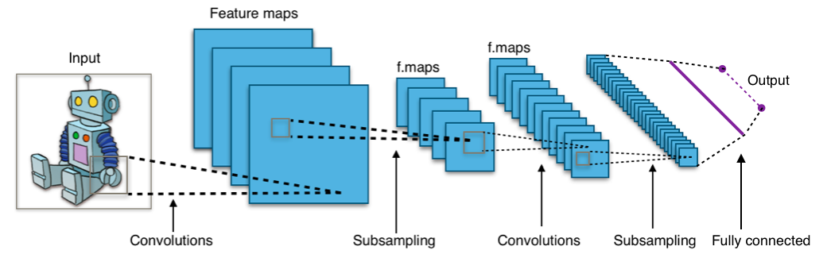
Convolutional Neural Network (CNN)

Slide 9
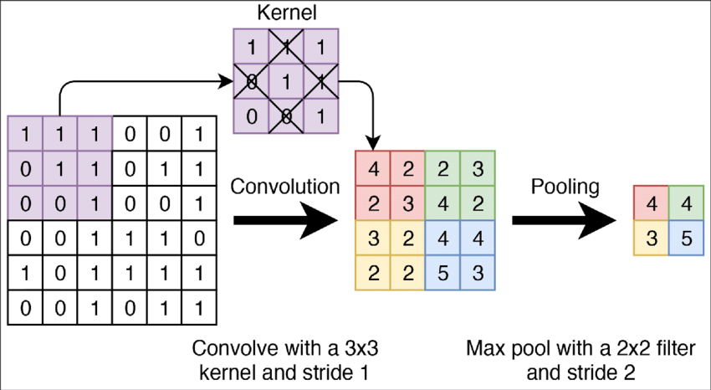
CNN – Core Components
Convolution Layer
  Applies learnable filters (kernels) over local regions
  Each filter detects a specific pattern
    Edges, Textures and shapes
Pooling Layer
  Down-samples feature maps
  Reduces:
    Spatial resolution and Sensitivity to small shifts
  Common types:
    Max pooling/Average pooling
Activation Function
  Introduces non-linearity
  Common choices:
    ReLU/Leaky ReLU

Slide 10
CNN – Properties and Limitations
Strengths
  Strong inductive bias for spatial data
  Parameter-efficient due to weight sharing
  Translation equivariance
  Works great with:
    Image classification
    Object detection
    Image-based diffusion models
Limitations
  Limited ability to capture global context
  Receptive field grows slowly with depth
  Less suitable for:
    Long-range dependencies
    Sequential or symbolic data

Slide 11
Recurrent Neural Network (RNN)
Many real-world data are sequential:
  Text, Time series, Sensor signals, Motion trajectories, etc.
Thus, we need a model that is able to
  Process inputs in order
  Maintain a notion of memory
Key idea of RNN
  Use a hidden state to summarize past information and update it step by step.

Slide 12
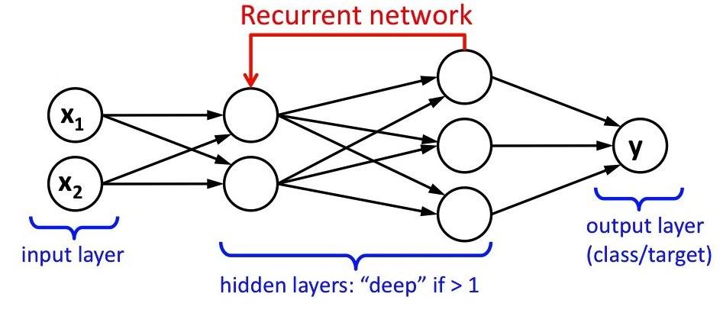
Recurrent Neural Network (RNN)

Slide 13
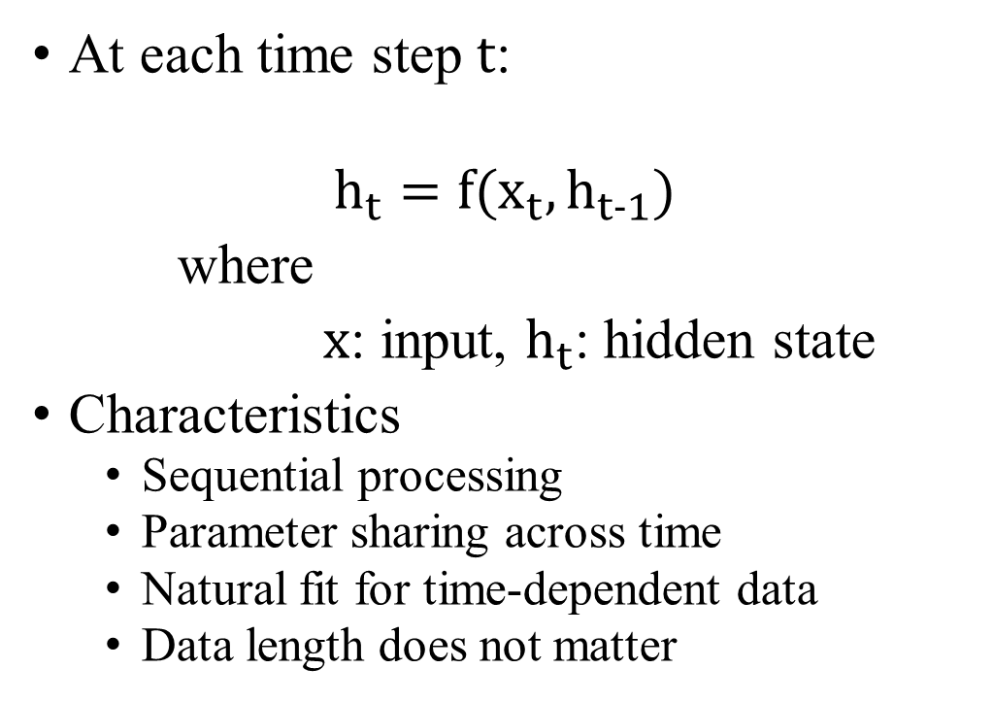
RNN: Basic Structure
At each time step $t$:
$$h_{t}=f(x_{t},h_{t−1})$$
where
$x$: input, $h_{t}$: hidden state
Characteristics
  Sequential processing
  Parameter sharing across time
  Natural fit for time-dependent data
  Data length does not matter
Limitations:
  Hard to capture long-range dependencies
  Training instability:
    Vanishing gradients
    Exploding gradients
  Limited parallelism

Slide 14
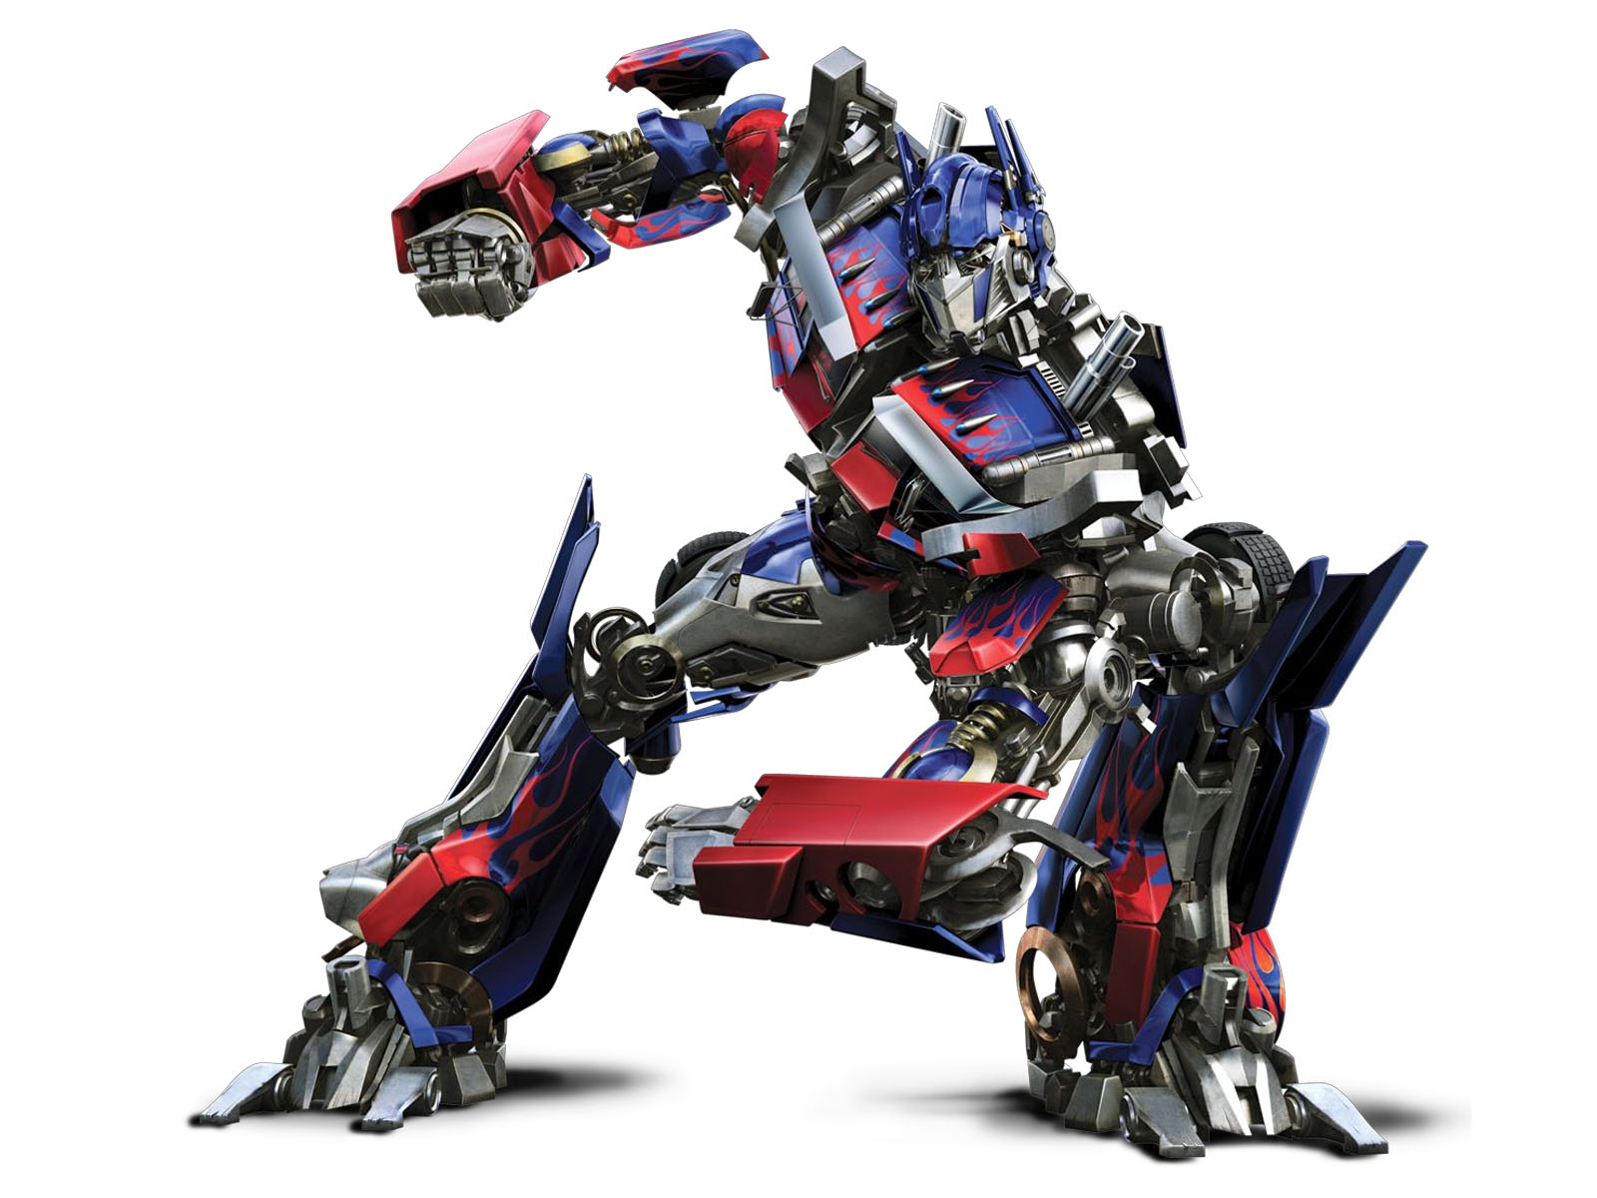
Transformers
RNN / LSTM suffer from:
  Sequential dependency (hard to parallelize)
  Vanishing / exploding gradients
Convolution (CNN)-based models:
  Limited receptive field
Thus, we need a model that:
  Captures long-range dependencies
  Is highly parallelizable
  Scales well with data and model size

Slide 15
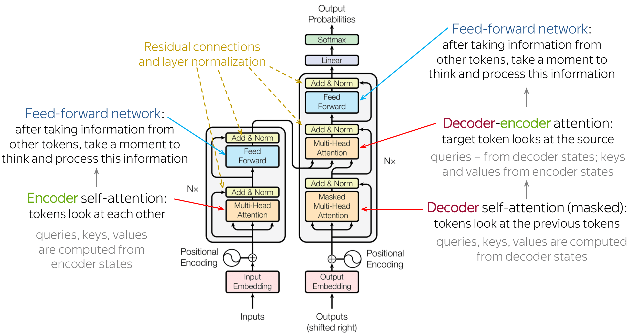
Transformers Model

Slide 16
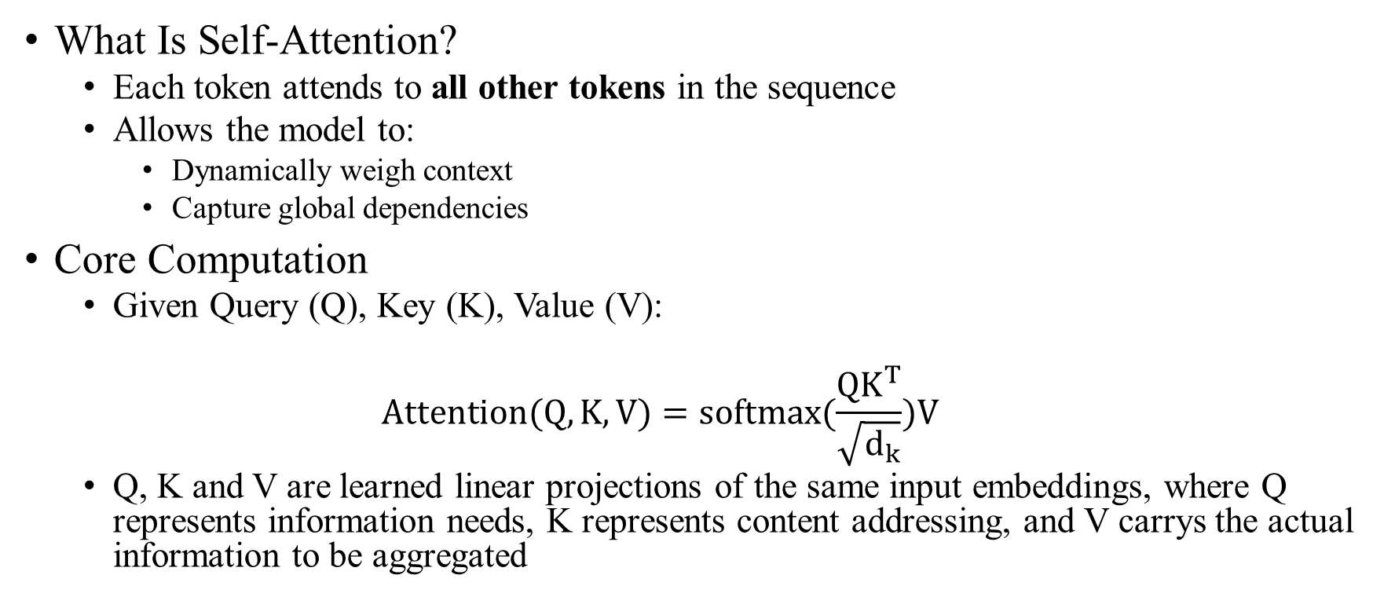
Key idea: Self-Attention Mechanism
What Is Self-Attention?
  Each token attends to all other tokens in the sequence
  Allows the model to:
    Dynamically weigh context
    Capture global dependencies
Core Computation
  Given Query (Q), Key (K), Value (V):
  $$Attention(Q,K,V)=softmax(\frac{QK^{T}}{\sqrt{d_{k}}})V$$
  Q, K and V are learned linear projections of the same input embeddings, where Q represents information needs, K represents content addressing, and V carrys the actual information to be aggregated

Slide 17
Transformers in Practice
Pros
  Scales well with data/parameters
  Unified architecture across modalities:
    Text
    Image
    Video
    Motion
  Backbone of modern LLMs and foundation models
Cons
  Quadratic complexity w.r.t. sequence length
  Memory-intensive attention computation

Slide 18
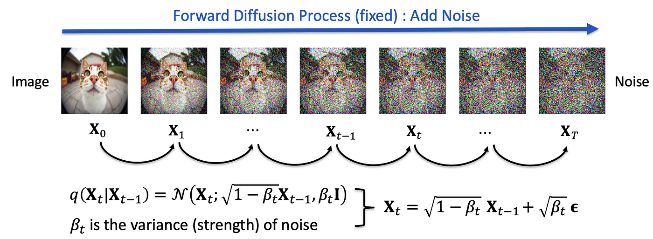
Diffusion Model

Slide 19
Common Neural Network Modelling Approaches

Slide 20
Diffusion Model
Many generative tasks require modeling complex, high-dimensional data distributions
  Hard to optimize, Sensitive to modeling assumptions
Diffusion transforms generation into a progressive denoising process
Core Concept
  Diffusion models consist of two processes:
    Forward diffusion: gradually corrupt data by adding Gaussian noise
    Reverse diffusion: learn to remove noise step by step to generate samples
  The generation process starts from pure noise and gradually produces a realistic sample

Slide 21
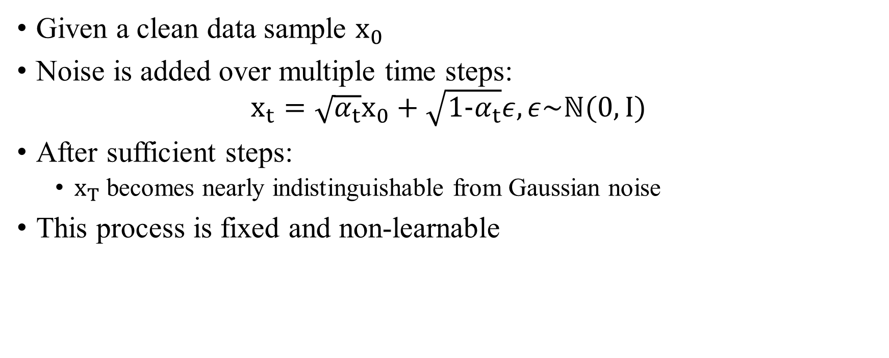
Forward Diffusion Process
Given a clean data sample $x_{0}$
Noise is added over multiple time steps:
$$x_{t}=\sqrt{α_{t}}x_{0}+\sqrt{1−α_{t}}ε, ε\sim ℕ(0, I)$$
After sufficient steps:
  $x_{T}$ becomes nearly indistinguishable from Gaussian noise
This process is fixed and non-learnable

Slide 22
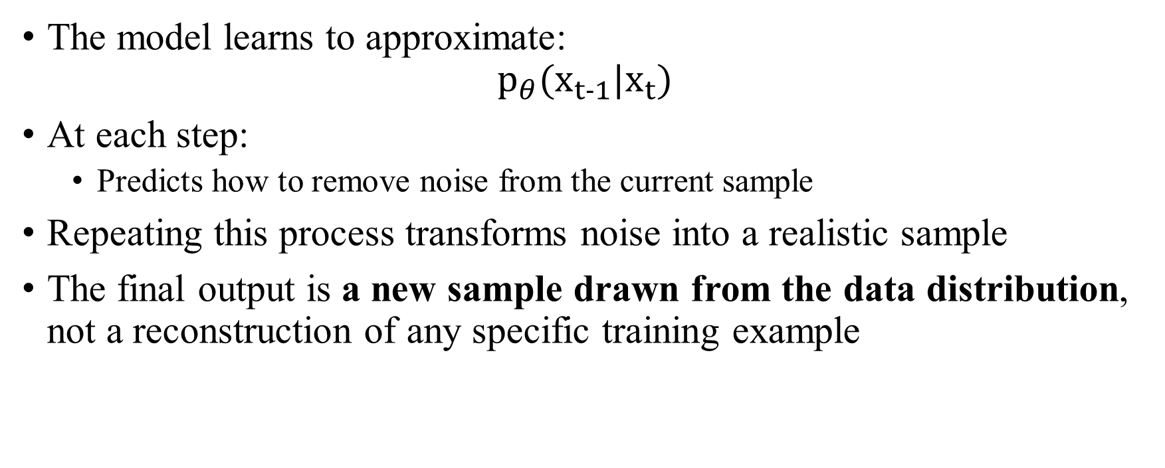
Reverse Denoising Process
The model learns to approximate:
$$p_{θ}(x_{t−1}|x_{t})$$
At each step:
  Predicts how to remove noise from the current sample
Repeating this process transforms noise into a realistic sample
The final output is a new sample drawn from the data distribution, not a reconstruction of any specific training example

Slide 23
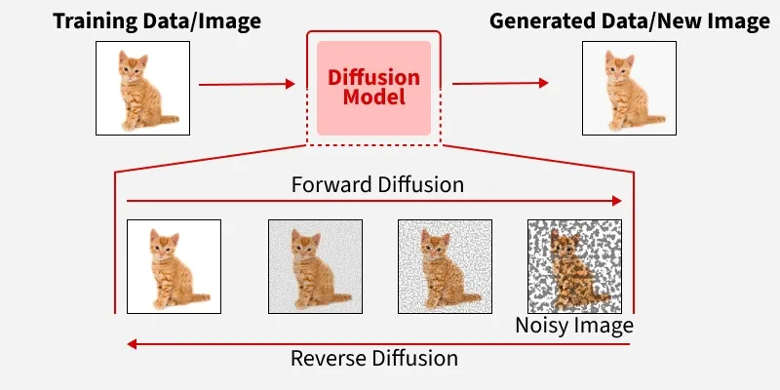
Diffusion Model Overview

Slide 24
Backbones for Diffusion Models
Usage Scene | Frequently Used Backbone(s)
Image Diffusion | U-Net (CNN)
Latent Diffusion | U-Net + Transformer
Text/Token Diffusion | Transformer
Motion Diffusion | Transformer/Hybrid
Video Diffusion | U-Net + Transformer

Slide 25
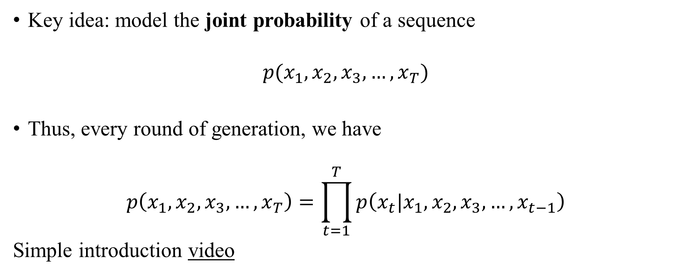
Auto-Regressive (AR) Models
Key idea: model the joint probability of a sequence
$$p(x_{1}, x_{2},x_{3},…,x_{T})$$
Thus, every round of generation, we have
$$p\left(x_{1}, x_{2},x_{3},…,x_{T}\right)=\prod_{t=1}^{T}{p\left(x_{t}|x_{1}, x_{2},x_{3},…,x_{t−1}\right)}$$
Simple introduction video

Slide 26
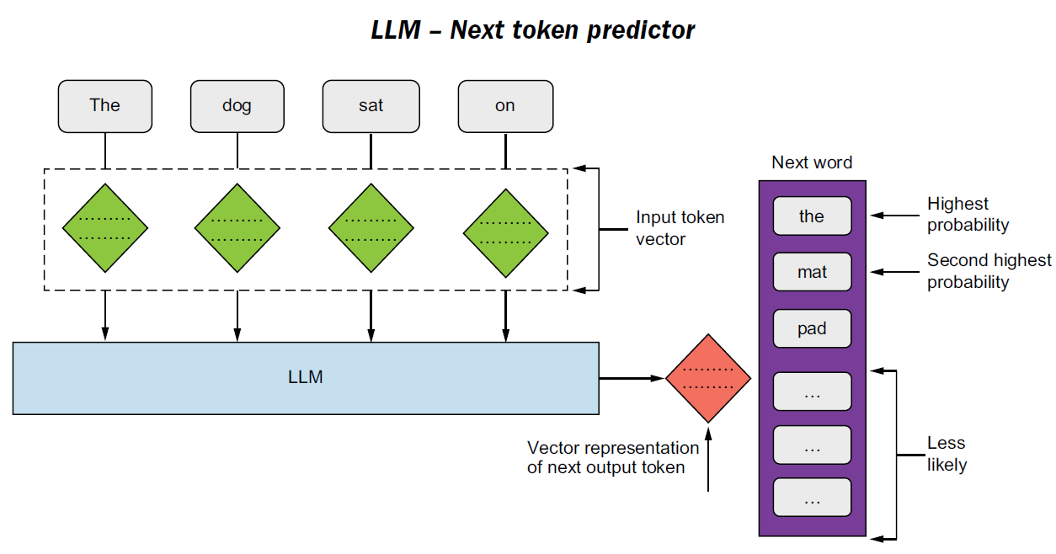
AR Example: LLMs
Input shape
  1 * token length
  Add 1 token for each iteration (answer from the previous iteration)
Output shape
  1 token for each iteration
  1 * 1 * vocab size
  Predicted token: argmax(output)

Slide 27
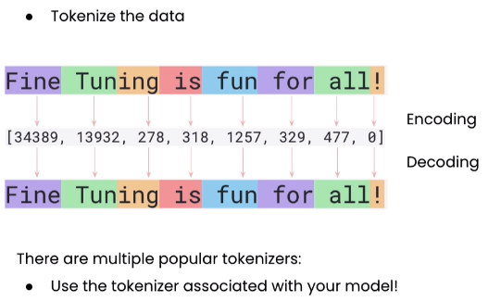
Basic LLM Components
Tokenizer (encoder/decoder)
  LLM model does not take strings directly. All input needs to be converted into tokens.
Processor (for multi-modal)
  Tokenizer for image/video
LLM Model
  Transformer layers that converts input tokens to output tokens

Slide 28
Some Parameters
max_length: Total length of the sequence.
temperature: Sampling temperature (lower→more conservative)
repetition_penalty: Penalize repeated tokens.
bad_words_ids: Lists of token IDs to forbid.
num_beams: Number of beams for beam search.

Slide 29
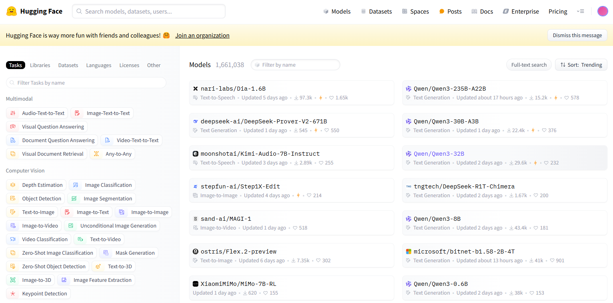
SOTA LLM Lookup
https://huggingface.co/models

Slide 30
LLM - Agent
An LLM Agent is a system that uses a Large Language Model as a reasoning core to perceive, decide, and act in an environment through iterative interaction.
Standard LLM:
  Input → Text generation → Output
  Does not affect the real world (i. e. the codebase)
LLM Agent:
  Observation → Reasoning → Action → Feedback → (Loop)

Slide 31
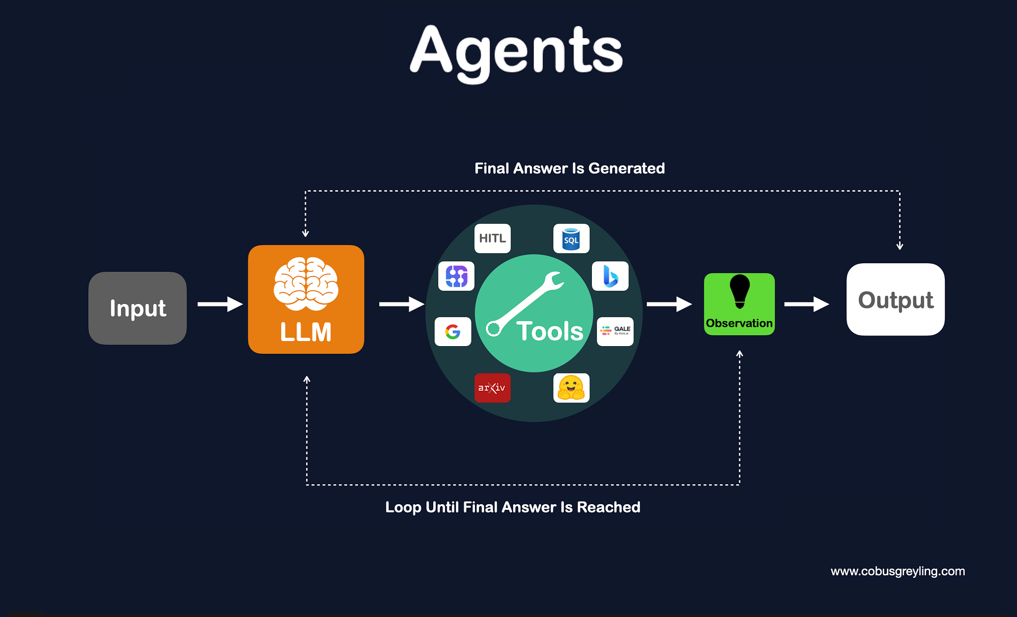
LLM Agent

Slide 32
LLM Agent – What Makes It an “Agent”?
An LLM-based system is typically called an Agent if it satisfies:
  Autonomy
    Can make decisions without step-by-step human instructions
  Goal-directed behavior
    Acts to maximize task success
  Iterative interaction
    Uses feedback to adjust actions
  Tool use
    Can call external functions or systems

