Slide 1
5G Framework
Presenter: Zhuoyuan Liu
Supervisor: Xin Liu

Slide 2
Content
5G background
5G layers and modules
How 5G works - example:
- Phone call
- Web browsing
- IOT

Slide 3
5G Background
Motivation
Explosive growth of:
- Mobile data (video, AR/VR)
- Massive IoT devices
- Ultra-low latency applications (AI)
4G limitations:
- High latency (~50 ms)
- Limited device density
- Fixed architecture
5G Goals
- Higher data rates
- Ultra-low latency
- Massive connectivity
- High reliability
Notes:
Network slicing allows different uses on the same infrastructure without mutual interference, like IOT+phone call+autonomous car

Slide 4
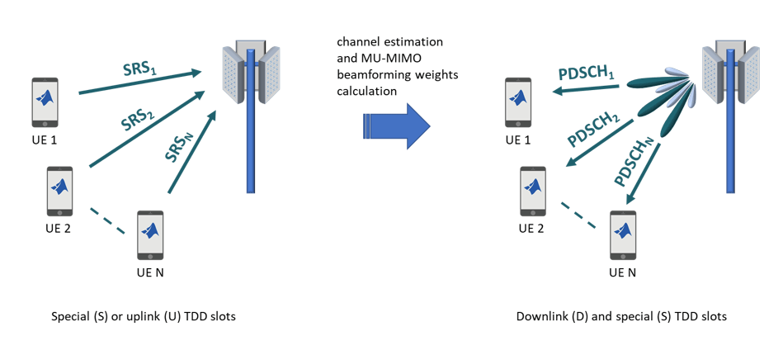
Features of 5G
Higher data rates (Gbps): Wider bandwidth; Advanced modulation; Massive MIMO Spatial multiplexing; Beamforming; error correction (LDPC, Polar code)
Ultra-low latency (<1 ms): Edge computing; CP/UP separation
Massive connectivity (10⁶ devices/km²): mMU-MIMO; scheduling
High reliability: Network slicing allows concurrent different uses on the same infrastructure
Notes:
256-QAM+OFDM more than 100 elements; can form many beams for many UEs, compared to 4G, if the user gets more, the beam will deer

Slide 5
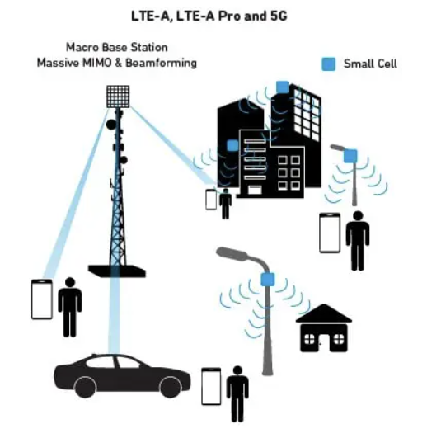
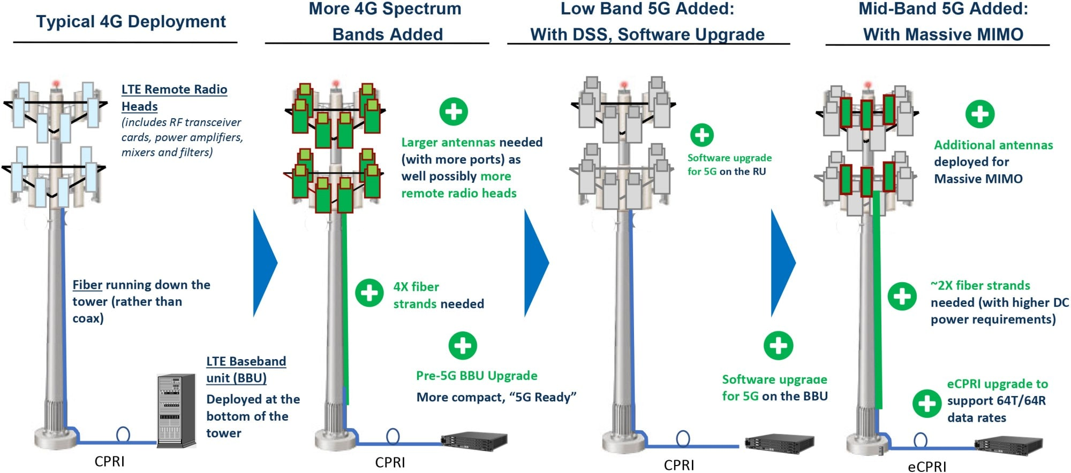
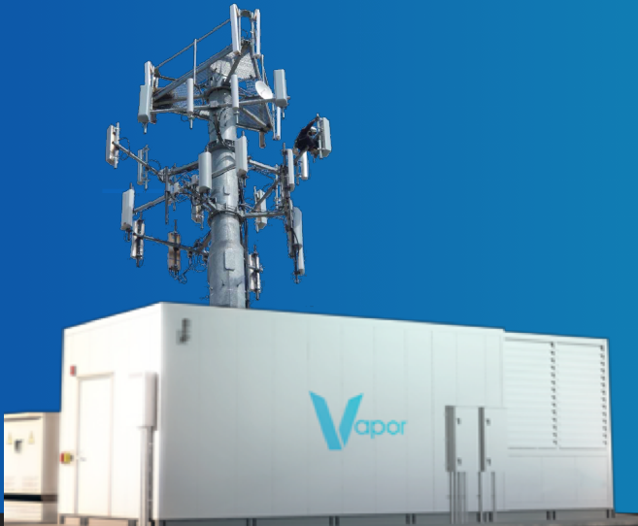
5G Infrastrutre
Main Components
UE (User Equipment) Phones, sensors, vehicles
ORAN (Open Radio Access Network)
gNodeB (5G base station)
5G Core (5GC)
Cloud-native, service-based (edge/central data center)
* How Much Does it Cost to Build a Cell Tower? - Dgtl Infra
Notes:
RRC (Radio Resource Control) NAS(Non-access stratum)
Main cell tower, upgraded baseband unit and dynamic spectrum sharing, support both 4G and 5G,
5G will use main cell tower and small cells mounted on street lamps, building top, or even indoor ceiling
Edge data center (servers inside), near cell tower, and near UE, allow low latency

Slide 6
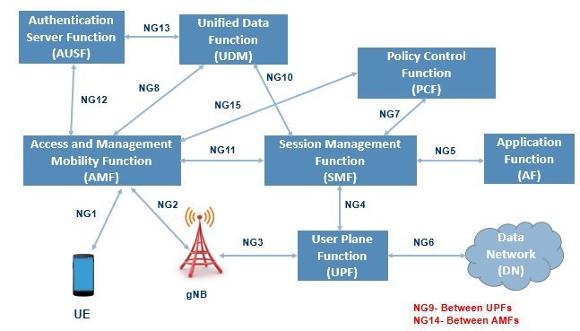
5G Core Network Modules
Key Core Functions
AMF – Access & Mobility Management
SMF – Session Management
UPF – User (Data) Plane Function (data forwarding)
AUSF – Authentication
PCF – Policy Control
NRF – Network Function Registry
Notes:
“The 5G core is built using a service-based architecture, where each network function has a clearly defined role and can scale independently.” “AMF is responsible for connecting devices to the network. It handles registration, mobility management, and handovers as users move between cells. You can think of AMF as the main control point that knows where a device is and whether it is allowed to access the network.” “SMF manages PDU (protocol data unit) sessions, which are the logical data connections between a device and the data network. It assigns IP addresses, selects the appropriate UPF, and configures how user traffic should be handled.” UPF is the 5G Core function that runs as software on servers in edge or central data centers, forwards user data packets between the radio network and external data networks (Internet, apps, edge services). “AUSF performs user authentication. It verifies device and subscriber credentials, ensuring only authorized users can access the network. This function is critical for security.” “PCF defines and enforces network policies, such as QoS rules, charging policies, and access restrictions. It ensures different services—like voice, video, and IoT—receive appropriate network treatment.” “NRF acts like a service directory for the 5G core. It keeps track of all available network functions and allows them to discover and communicate with each other dynamically.”

Slide 7
5G layers
From Bottom to Top:
1. Physical Layer (L1)
mmWave, OFDM, massive MIMO
2. MAC / RLC / PDCP (L2)
Scheduling
Error correction
Encryption & compression
3. Transport & IP (L3)
UDP/TCP
QoS-aware routing
4. Application Layer
Voice, video, IoT data

Slide 8
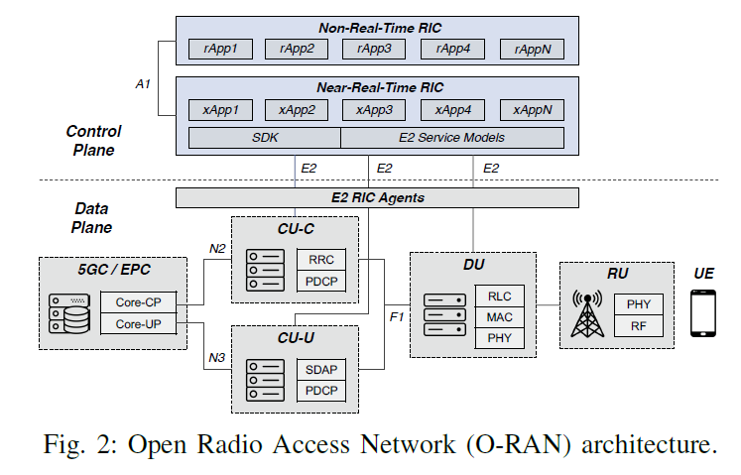
5G modules and layers
gNB-RU
Physical layer
RF manipulation
gNB-DU
Lower-layer protocols
Real-time radio processing
gNB-CU
Higher-layer protocols
Control & user plane processing
5GC/EPC (Central/Edge)
session control
Mobility
routing to internet
L1 — Physical Layer
Radio transmission
OFDM, MIMO, mmWave
Mostly in DU
L2 — Data Link Layer
MAC – scheduling
RLC (Radio Link Control) – retransmission
PDCP – encryption, compression Split between DU and CU
L3 — Network Layer
IP routing
Mobility anchoring
QoS enforcement Mostly in CU + 5G core
*Put in the last, talk about O-RAN, multi-vendors…, open source
Radio Access Network (RAN) is the wireless part of a cellular network, connecting user devices (phones, tablets) to the core network via radio waves, using antennas and base stations to translate signals, enabling services like calls, texts, and data.
Notes:
RAN Intelligent Controller (RIC) is a key software component in Open RAN architecture (O-RAN) that centralizes and automates the control and optimization of the Radio Access Network (RAN) using AI/ML. It decouples RAN functions, allowing third-party applications (xApps/rApps) to run on it, enabling flexible resource management, network slicing, improved performance, and new services with better Quality of Experience (QoE) for users mobility: Connection needs to be maintained even when the user equipment moves across cells RRC (Radio Resource Control) PDCP ( Packet Data Convergence Protocol)

Slide 9
Control Plane vs User Plane
Control Plane (in 5GC)
Signaling
Authentication
Mobility management
User Plane (in 5GC+gNB+UE)
Actual data (voice, video, sensor data)
Control and data can take different paths Enables edge computing & low latency
Notes:
Signaling is control-plane communication used to establish, manage, and maintain network connections and services.
What Signaling Does (Key Roles)
Connection Setup
Network access & registration
Session establishment
IP address assignment
Authentication & Security
Verify device and subscriber identity
Set up encryption and integrity protection
Mobility Management
Handle handovers as users move
Paging and tracking
Resource & QoS Control
Decide how much bandwidth to allocate
Set latency and priority rules
Session Control
Start, modify, and end services
Voice/video call setup and teardown

Slide 10
Fundamental Problems – How does 5G works?
How can a cellphone join a network (finding which cell it is in, notifying the base station)?
How can a cellphone make a phone call (the phone initiates the data transfer)?
How can a cellphone be called (the base station initiates the data transfer)?
How can a cellphone receive continuous service even when moving (handover)?
How to plan the network optimally to cover the area?
Notes:
Cell best SINR, support frequency band, support phone’s mobile service provider

Slide 11
5G Basics -- Terms
Base station: called gNodeB
User device: called UE
gNB may connect to each other with an interface named X2; gNB may connect to the Evolved Packet Core (EPC) with an interface called X1

Slide 12
5G Basics -- Joining an LTE network
High level description:
The UE receives the broadcast signals from neighboring gNBs and finds the one with the strongest signal.
The UE sends connection request with the help of a random access channel to the selected gNB, which may accept the request.

Slide 13
5G Basics -- Initiating data transfer from a cellphone
High level description:
LTE has an uplink channel for random access. A UE can inform the gNB by following the random access protocol and request resources for data transfer

Slide 14
5G Basics -- Finding a UE
High level description:
The gNB keep records of the UEs associated with it. If there are data destined to this UE from the backbone network, the gNB will send a signal to notify this UE

Slide 15
5G Basics -- Handover in 5G
High level description:
The UE and gNBs constantly monitor the signal quality and will switch the UE to another gNB if it will receive better signal or achieve better network utilization

Slide 16
Main service categories for 5G networks
eMBB (Enhanced Mobile Broadband):
video streaming, AR/VR
URLLC (Ultra-Reliable Low-Latency Communications):
remote surgery, autonomous cars (partially)
mMTC (massive Machine-Type Communications):
smart cities, sensors
These distinct requirements are met through network slicing, allowing tailored resource allocation for different services

Slide 17
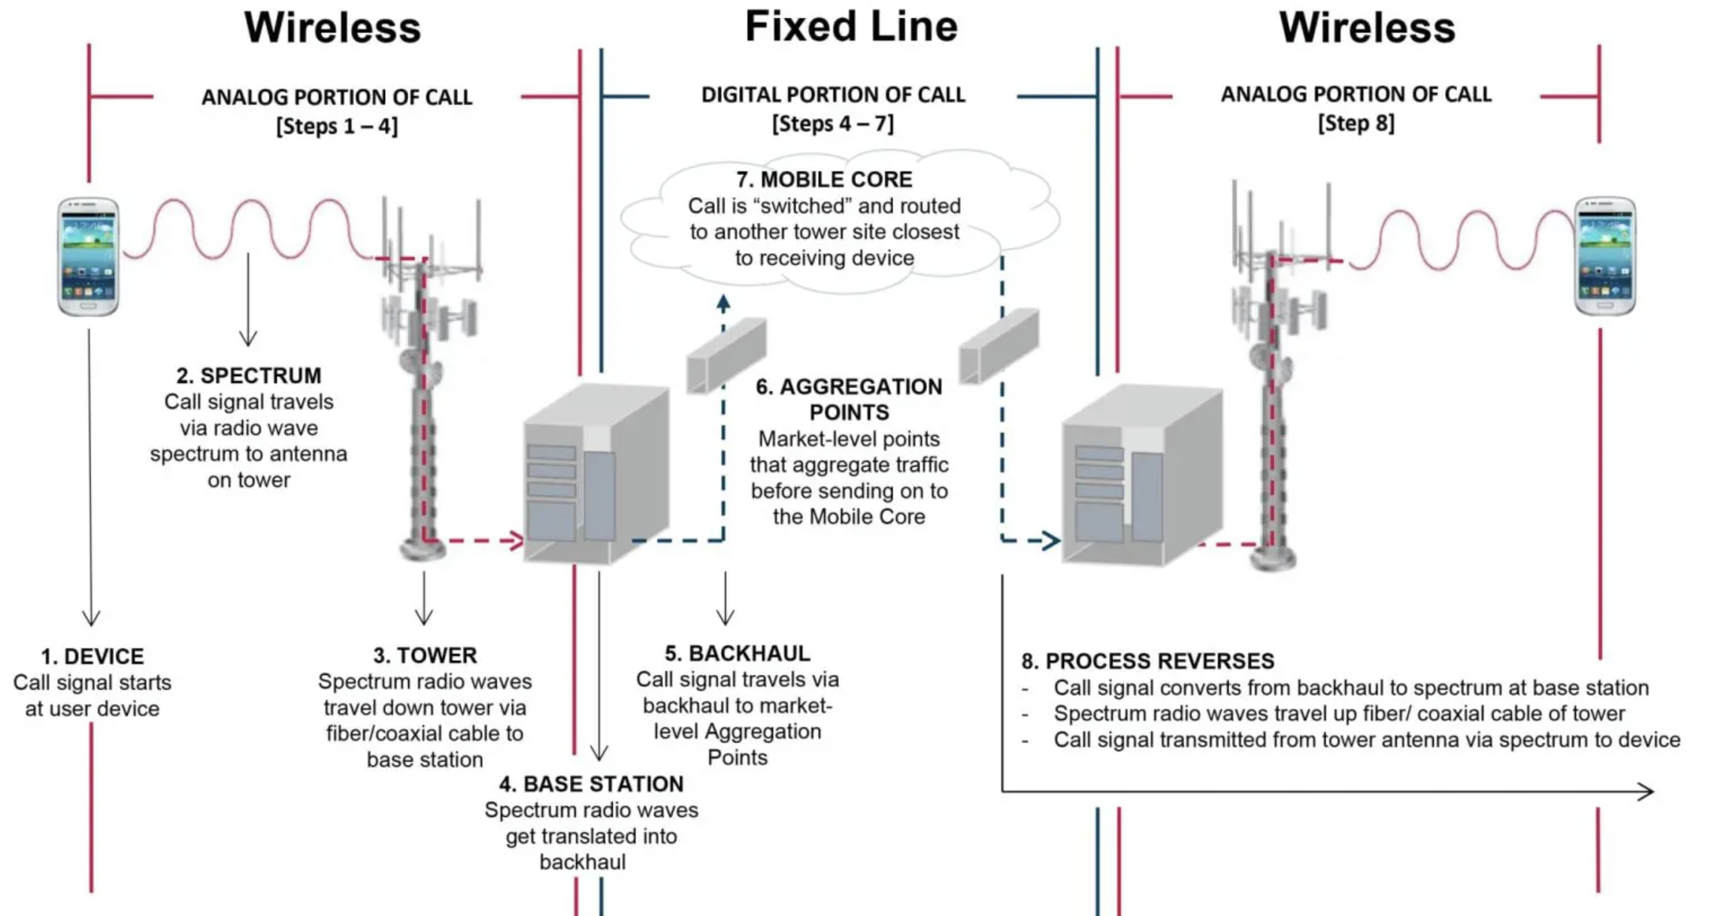
Example: Voice/Video call (eMBB/URLLC)
Steps
1. UE1 connects to gNodeB1
2. AMF (Access and Mobility Management Function) already authenticated device
3. SMF (Session Management Function) already set up session
4. Call begins: Radio signal from UE1 – gNB1 – data center. Voice/Video packets routed via UPF (at data center). UPF anchor mobility; Data center also relays/records/encrypts the data.
5. Voice/Video Packets forwarded to the gNB2 closest to the destined UE according to the IP (e.g. phone number, device IP). Radio signal from gNB2 – UE2
*What is a Cell Tower? Understanding How Cell Towers Work - Dgtl Infra
Notes:
In 5G standalone (SA), voice calls use VoNR, meaning the phone call is entirely carried as IP traffic over 5G NR and is controlled by the IMS core. The device first registers with the 5GC, then establishes a QoS-guaranteed PDU (Protocol Data Unit) session for the voice call, and finally the media (voice packets) flows peer-to-peer using the dedicated bearer.

Slide 18
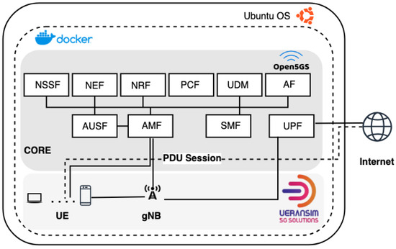
Example: Web browsing (eMBB)
*Cyber5Gym: An Integrated Framework for 5G Cybersecurity Training
Similar to phone call. But the destination is the web server, not the other UE.
Edge DC might save web caches, faster load time.
AUSF: Authentication, AMF: registration, mobility management
Notes:
When you browse the internet on 5G, your phone sends IP packets over the 5G radio to a base station, which forwards them through the 5G Core to the internet, and the responses return the same way.
1. Your phone (UE) sends data over 5G to gnB. 2. Phone already has a PDU (Protocol Data Unit) session. The session assigns: An IP address and QoS parameters, is managed by the 5G Core (AMF/SMF). This usually happens in the background and is already done before browsing. 3. User Plane Forwarding (gNB → UPF). UPF acts like a router, applies QoS and traffic rules. 4. UPF forwards packets to: ISP backbone- Internet routers- Web server. Website Response (Reverse Path). If with edge server, Some content served from edge caches, Even faster load times

Slide 19
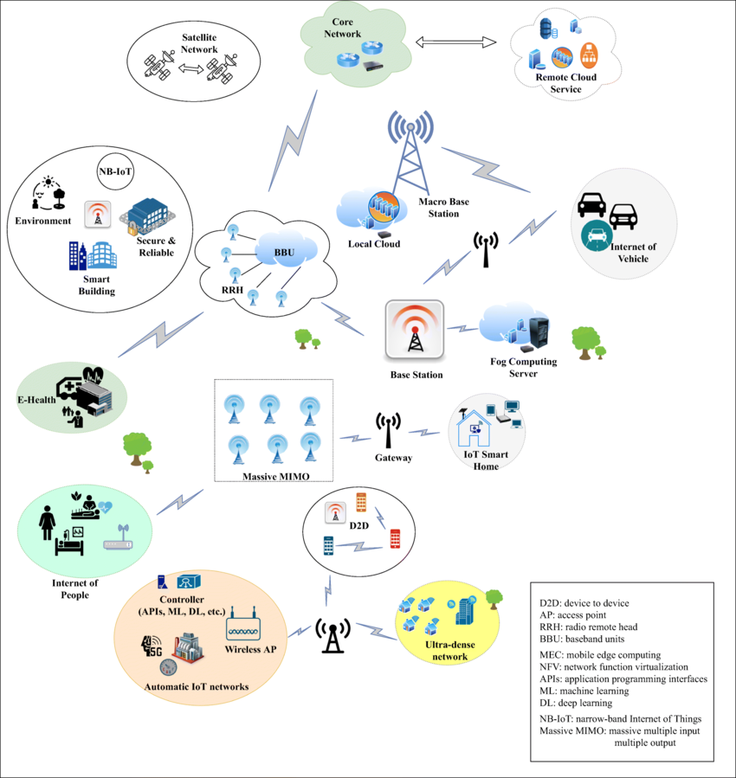
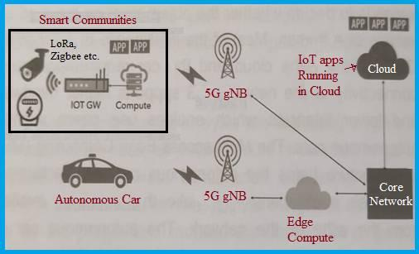
Example: IOT (mMTC)
Edge DC processes data locally
Central DC does analytics (AI computation)
- e.g. Smart power grid, Autonomous traffic
*The overall IoT network environment in 5G network | Download Scientific Diagram
Notes:
5G allows narrowband Internet of thing. These devices are low-power, spread in wide area, generate small and infrequent data packets. Devices connect wirelessly to 5G base stations. In many deployments, the radio is split into remote radio heads (RRH) near the antennas and baseband units (BBU) that handle signal processing. Massive MIMO antennas allow the base station to communicate with many devices simultaneously by using spatial beams. Example: environment data, multiple data, needs very high computation resource for large AI model, needs central DC. E.g, autonomous driving, plan an auto-driving route, know weather data, know traffic monitoring data, how to plan the route; e.g., Smart Grid – AI-Assisted Fault Detection & Recovery,
Electrical substations | power plant with:
Voltage/current sensors
Smart meters
Protection relays
Connected via 5G IoT.
Why AI Is Needed
Detect anomalies before failures
Predict cascading faults
Optimize load balancing
Why 5G Is Needed
Wide-area coverage
High reliability
Fast response to grid instability
Where AI Runs
Edge DC near substations for:
Fault detection (<10 ms)
Central cloud for:
Grid-wide optimization
Prevents blackouts through predictive intelligence

Slide 20
5G modules and layers
L1 — Physical Layer
Radio transmission
OFDM, MIMO, mmWave
Mostly in DU
L2 — Data Link Layer
MAC – scheduling
RLC (Radio Link Control) – retransmission
PDCP – encryption, compression Split between DU and CU
L3 — Network Layer
IP routing
Mobility anchoring
QoS enforcement Mostly in CU + 5G core
Data (user plane):
gNB-RU
Physical layer
RF manipulation
gNB-DU
Lower-layer protocols
Real-time radio processing
gNB-CU
Higher-layer protocols
Control & user plane processing
5GC/EPC (Central/Edge)
session control
Mobility
routing to internet
Control plane:
RIC — RAN Intelligent Controller
Control and optimize the RAN using AI/ML
third-party applications (xApps/rApps)
resource management, network slicing, QoE
Notes:
O-RAN, multi-vendors…, open source
Radio Access Network (RAN) is the wireless part of a cellular network, connecting user devices (phones, tablets) to the core network via radio waves, using antennas and base stations to translate signals, enabling services like calls, texts, and data. Open-RAN means that this wireless part has devices such as base station, antennas, baseband unit, and multiple vendors have different closed source devices and protocols and firmware, but with ORAN these can be made open source so that different devices can be integrated more freely, useful for setting up private ORAN network, e,g, in rural area, people in a community can set up such a network for things like ranch monitoring using cameras, inter-house communication etc.
RAN Intelligent Controller (RIC) is a key software component in Open RAN architecture (O-RAN) that centralizes and automates the control and optimization of the Radio Access Network (RAN) using AI/ML. It decouples RAN functions, allowing third-party applications (xApps/rApps) to run on it, enabling flexible resource management, network slicing, improved performance, and new services with better Quality of Experience (QoE) for users mobility: Connection needs to be maintained even when the user equipment moves across cells RRC (Radio Resource Control) PDCP ( Packet Data Convergence Protocol)

Slide 21
Q/A
Notes:
1. Can edge data Center process,Phone call/zoom, Internet browse, IOT? Yes.
2. How can a cellphone join a network (finding which cell it is in)? A cellphone joins a network by scanning for nearby cells, synchronizing to a base station’s broadcast signals, and then performing a signaling procedure to register with the core network. A UE selects the best cell by measuring broadcast signals from nearby cells and choosing the one that meets access requirements and provides the best signal quality according to standardized criteria.

